Slide 1
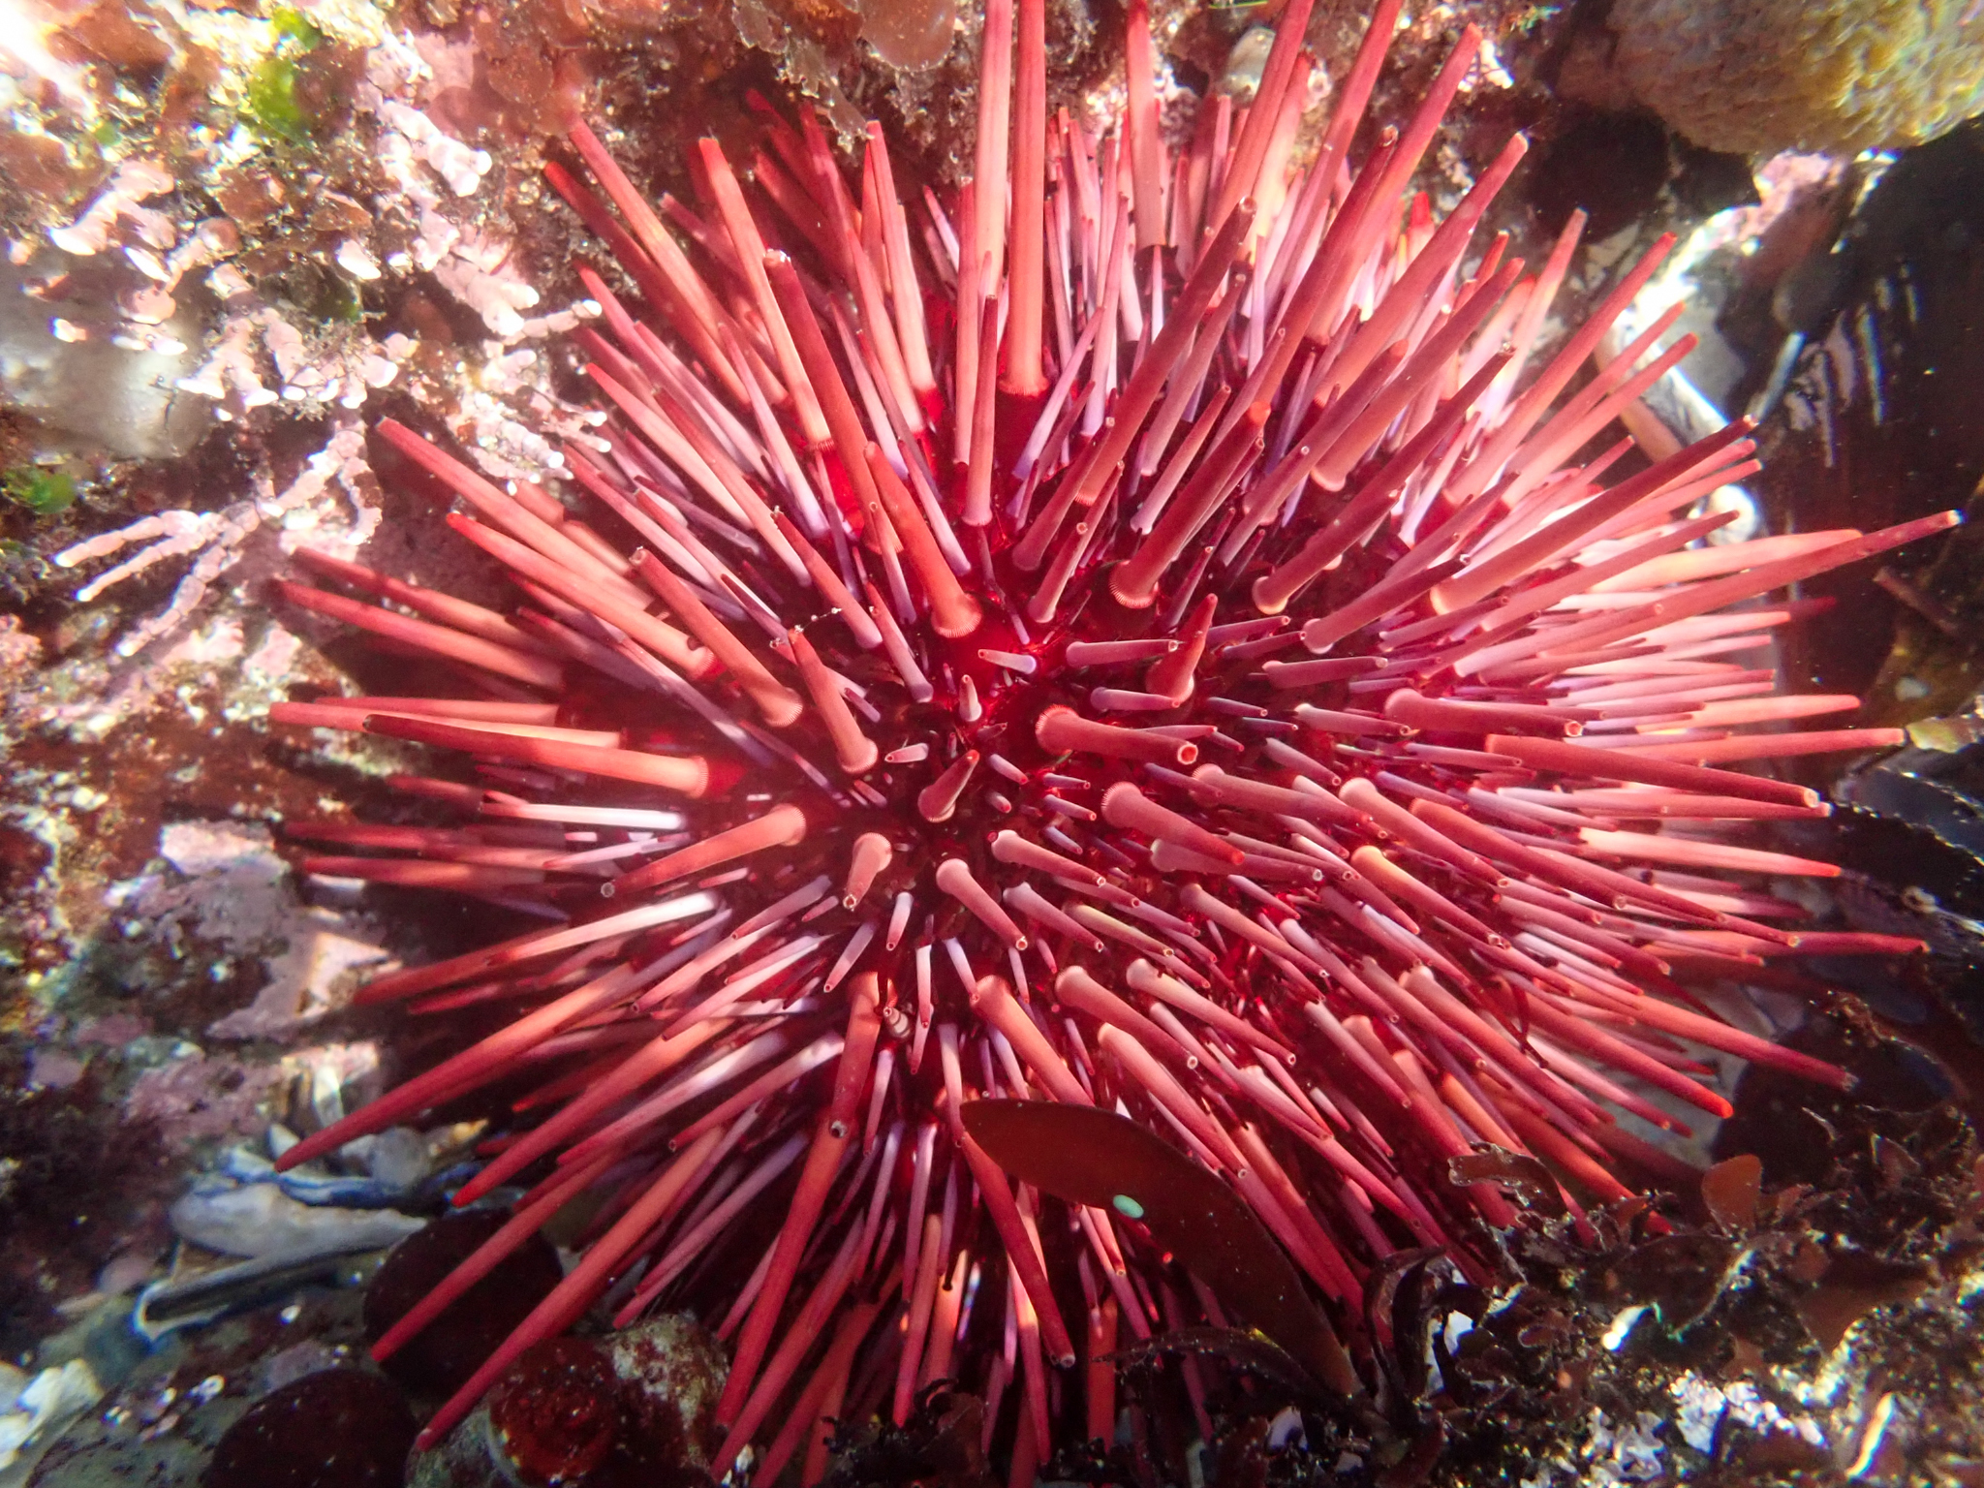
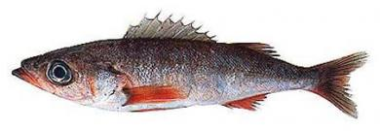
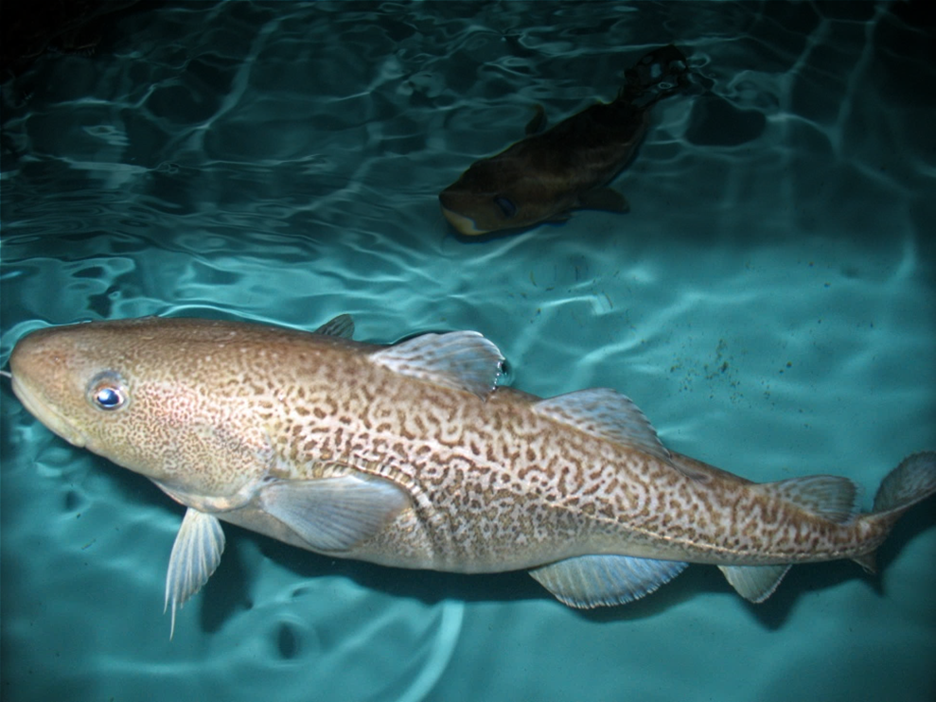
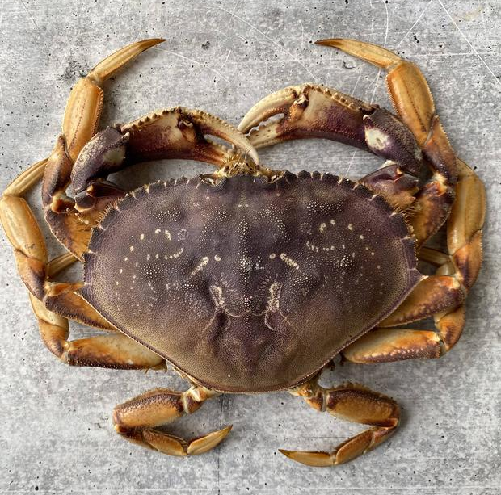
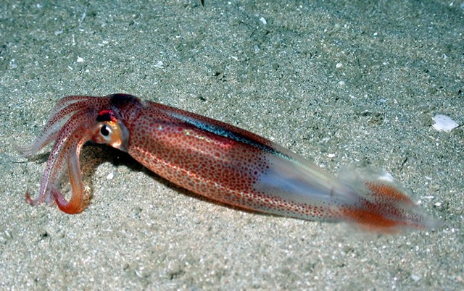
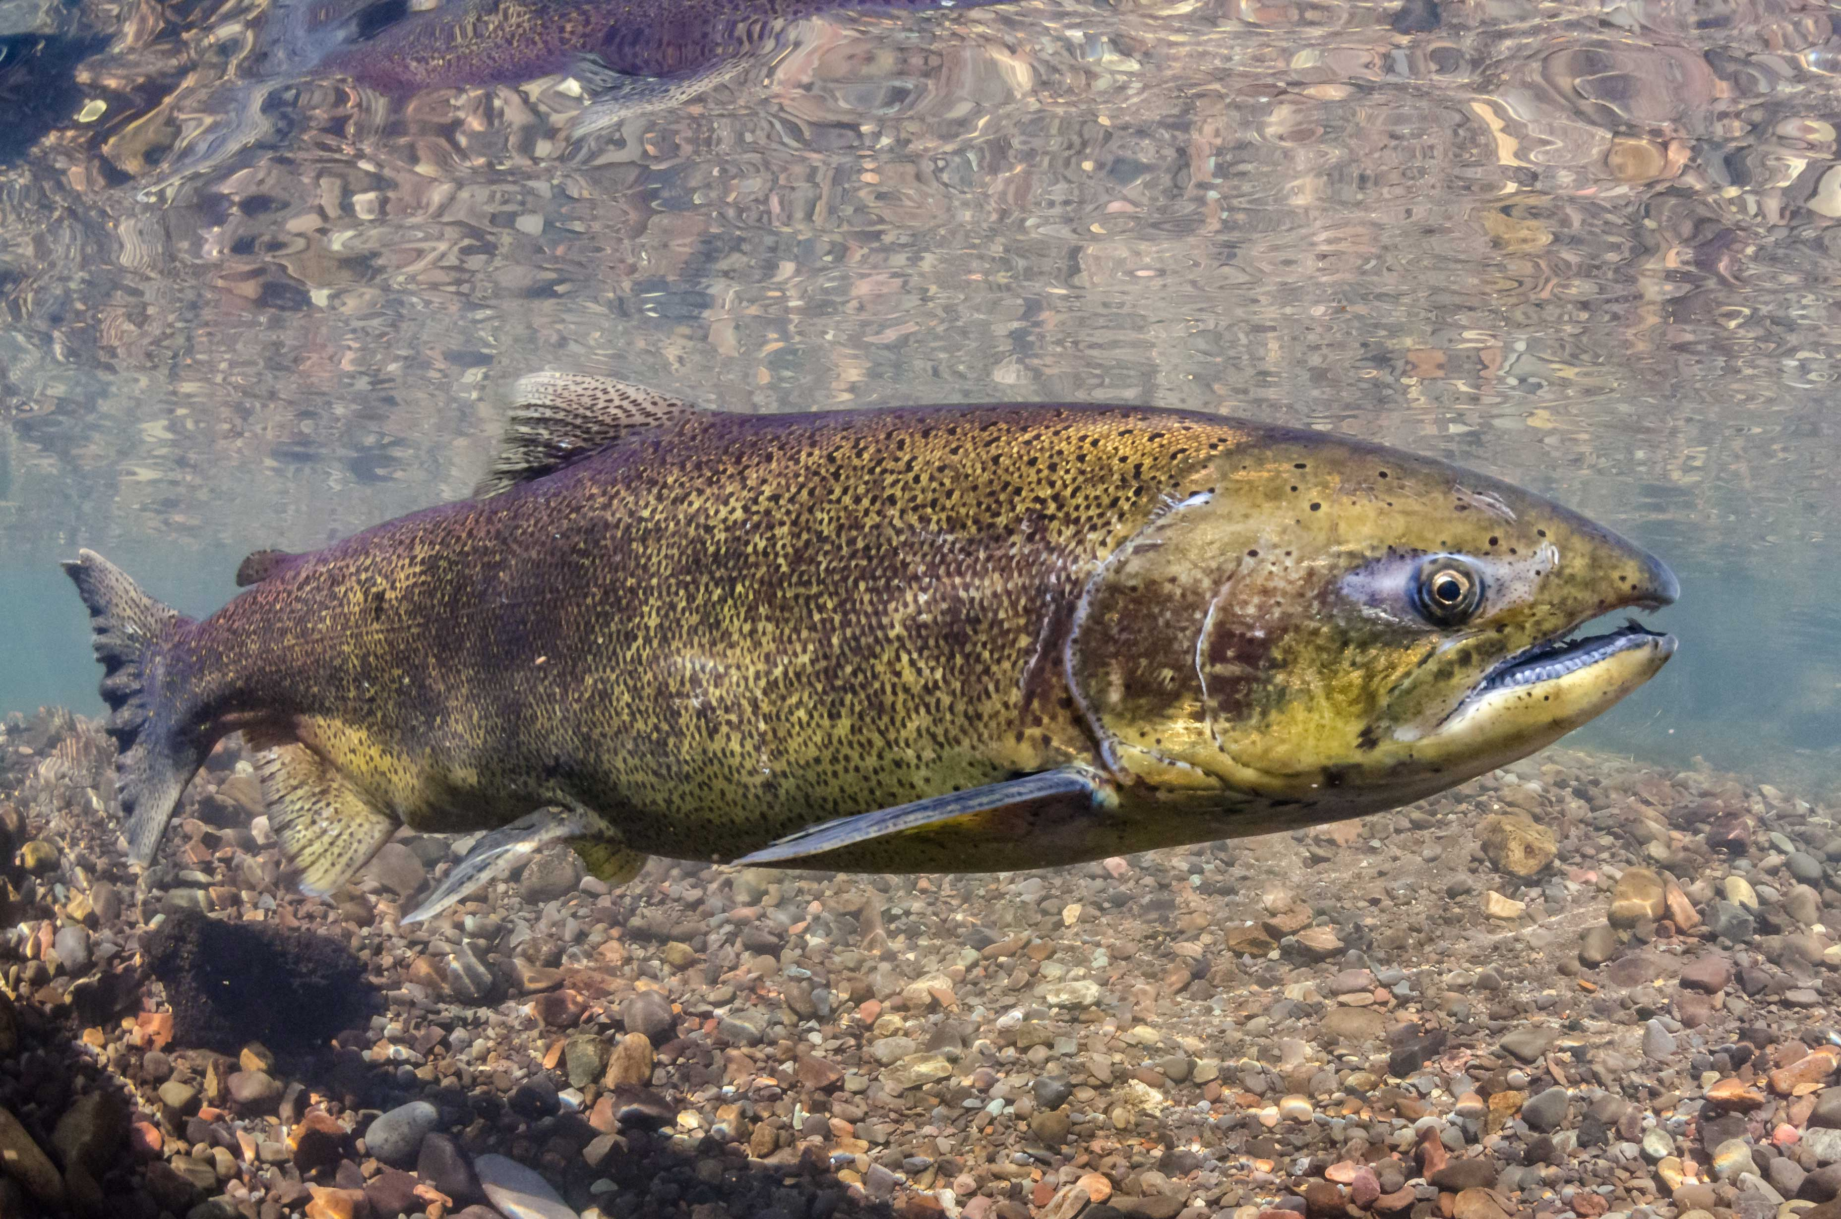
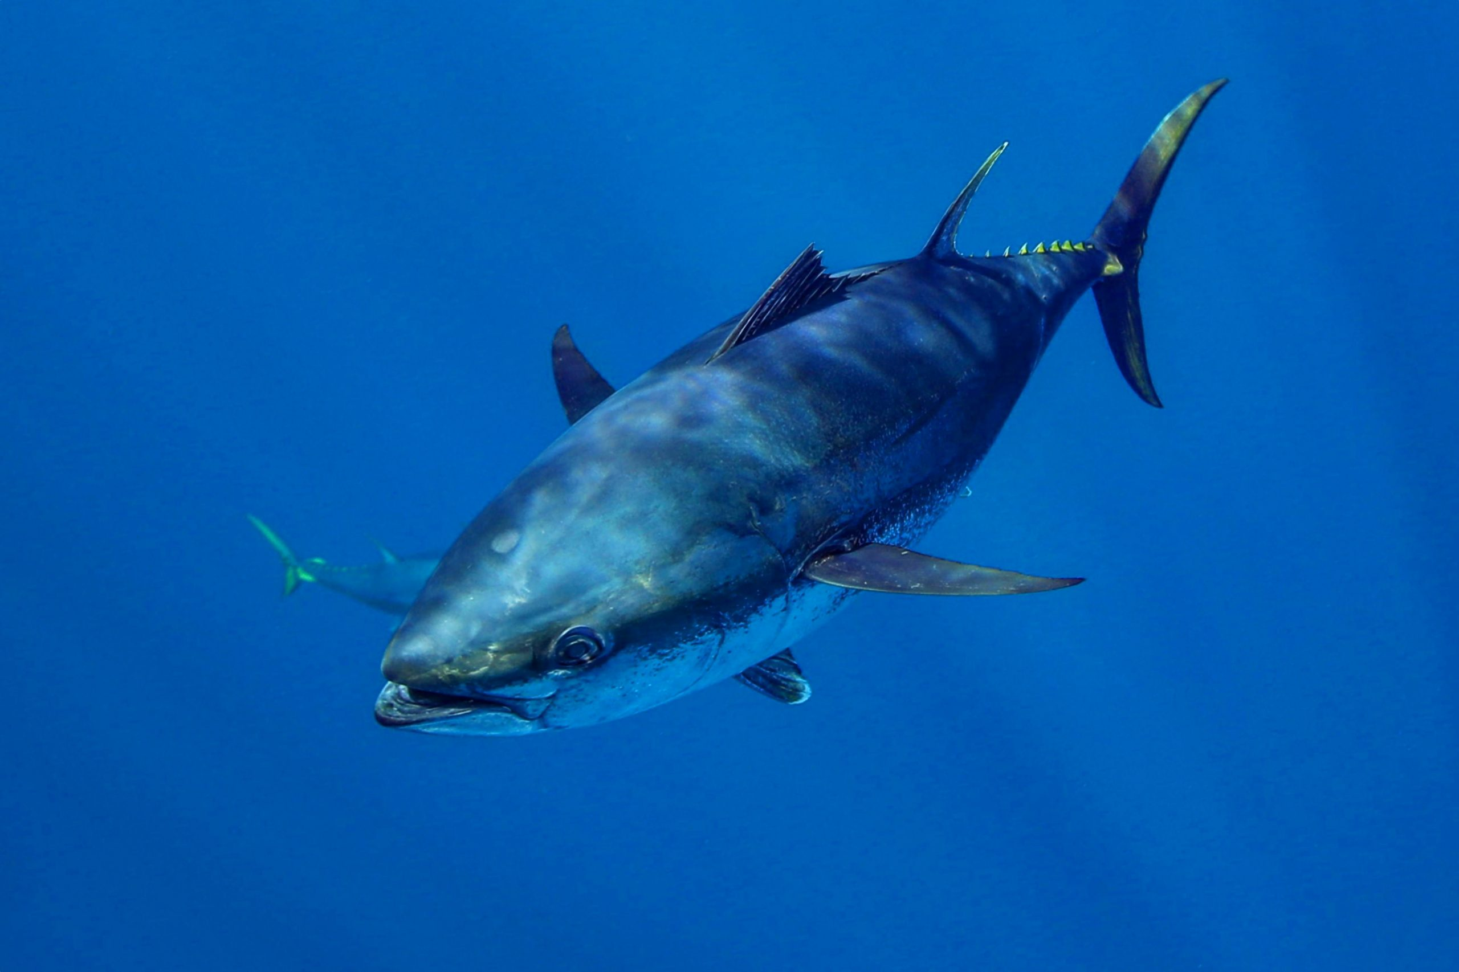
Red sea urchin
Population declines due to loss of kelp beds
Shortbelly rockfish
Increase in abundance approaches bycatch limits
Pacific cod
Population declines due to lost prey and increased metabolic demands
Dungeness crab
Fishery closures due HABs and whale entanglements
Market squid
Increases in distribution leads to unregulated emerging fishery
Chinook salmon
Overfished due to reduced productivity and model failure
Bluefin tuna
Increase in abundance a boon for rec industry
Direct negative impacts
Indirect negative impacts
Neutral
impacts
Positive impacts, w/ mgmt challenges
Positive impacts, w/out mgmt. challenges

